Slide 1
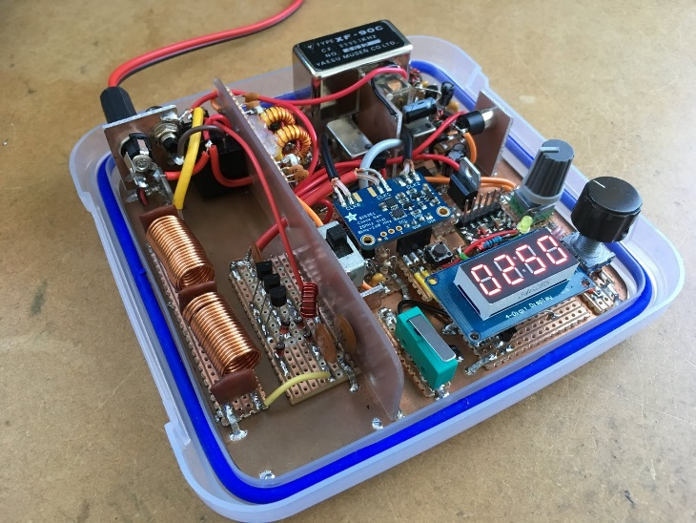

1.12 Software defined radio Initial Design Review
Sponsor: Texas State University
Faculty Advisor: Dr. Stapleton

Slide 2
Project Overview
Software Defined Radio High Frequency (HF) Transceiver
Non-Portable Half Duplex Radio Communications on the HF Band
Notes:
State the problem and the project in clear terms. Use a graphic if at all possible.

Slide 3
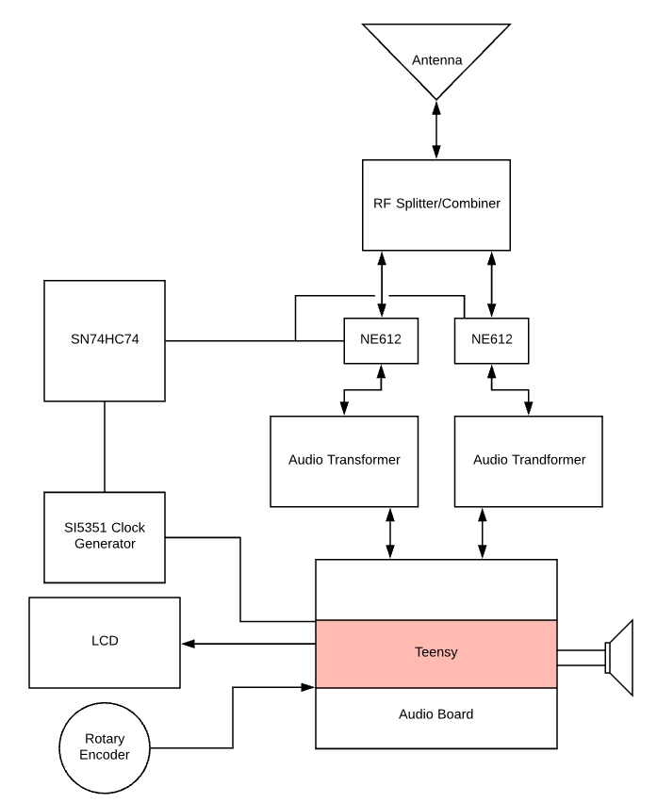
block diagram
NE612 : RF Mixers
SN74HC74 : D Flip Flop Network, Clock Divider and Quadrature Generator
SI5351: Voltage Controlled Oscillator, Sets the Carrier Wave Frequency
Audio Transformer: Audio Signal Isolator
Notes:
Put your project into the larger context.

Slide 4
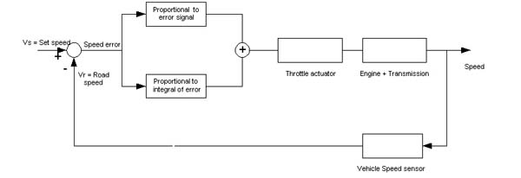
Cruise Control Functional Block Diagram
Automobile applications
Notes:
Show a functional overview of how it works. This applies to software or hardware or mix.

Slide 5
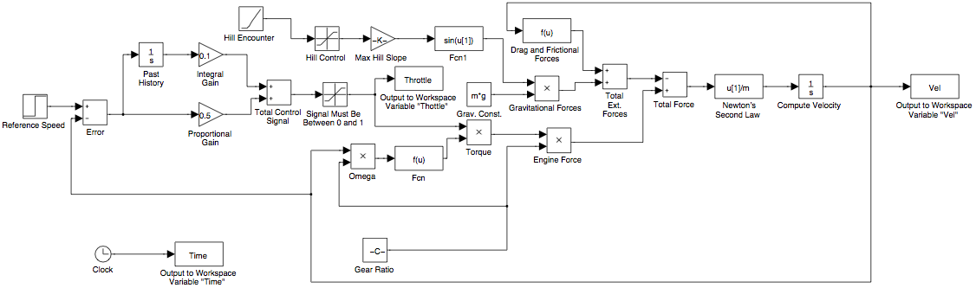
Cruise Control Detail Block Diagram
Give a few lines of detail regarding main features of the system
Notes:
Show deep technical detail. You may need more than one slide. Highlight in yellow the blocks that the team will be designing

Slide 6
Project Goals
Goals of Project
Stretch Goals of Project
To make a PCB for the radio
To make it operable for 4 hours on 12V battery power
To make a build kit for the radio
3D printed Case for safety
Have an operable 3.5mm headphone Jack
To create a Half-Duplex Software Defined Radio
To make an educational tool
Notes:
If no stretch goals then delete the text box on the right, and expand the one on the left. DO NOT ELABORATE ON THE GOALS, JUST STATE THEM QUICKLY AND MOVE ON!!!

Slide 7
Roles & Responsibilities
NAME | ROLE
James Bell, Project Manager | Coding for microcontroller
Samuel Hussey
Zachary Schneiderman
Notes:
BRIEF DESCRIPTIONS!!!!! Go over this VERY quickly!

Slide 8
Project-Specific Milestones NOT Course Deliverables
MILESTONE | Completion Date | Person(s)
Simulation of analog components
Be sure to include goals specific to the project, e.g.,
Parts Ordered; PCB initial layout for review; Initial simulations; Breadboard testing; Code Integrated – and so on.
Notes:
List the major milestones. They are milestones SPECIFIC to YOUR project and NOT deliverables for the class!!!

Slide 9
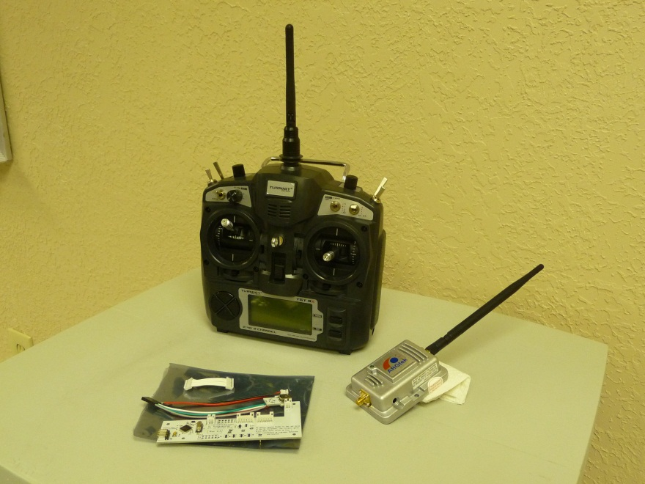
Project Deliverables
Launch system comprised of a high altitude balloon, nichrome wire, and timer
Design and fabricate long-range amplifier and programming board
Assemble glider capable of short term operation
Electronics and Solar Panels connected for ground test
These are examples, write your own!
Notes:
List the MAJOR deliverables only. These are the deliverables for your PROJECT and NOT for the class! E.g., don’t list “Functional Spec” etc.

Slide 10
Functional Specification Review

Slide 11
2.2 Administration Functions
Notes:
If this section is not relevant to your project then delete this slide. If relevant, talk to this slide for no more than 1 minute!

Slide 12
2.3 Error Handling
Notes:
Talk to this slide for no more than 1 minute! Remember: ALL designs must handle errors! You may have to think about what they might be!

Slide 13
2.4 Safety & Security
Notes:
If this section is not relevant to your project then delete this slide. If relevant, talk to this slide for no more than 1 minute!

Slide 14
You may need to have a block diagram – of various levels – available throughout the presentation to illustrate elements of the design!

Slide 15
2.61 – User Interfaces
Notes:
These are interfaces between the USER and your SYSTEM.

Slide 16
2.62 – Software Interfaces
Notes:
These are interfaces between one piece (or language) of software and another due to your design. If this section is not relevant to your project then delete this slide.

Slide 17
2.63 – Hardware Interfaces
Notes:
These are interfaces between two pieces of hardware, e.g., you connected a sensor to a pi. If this section is not relevant to your project then delete this slide.

Slide 18
2.64 – Mechanical Interfaces
Notes:
These are interfaces between two mechanical systems like a motor and a generator. If this section is not relevant to your project then delete this slide. FEW projects have mechanical interfaces.

Slide 19
2.7 Boundary Conditions & Constraints
Notes:
List the boundary conditions and make sure your Sponsor agrees that they are indeed boundary conditions. Talk to this slide for no more than 1 minute!

Slide 20
2.8 Performance
Software Performance Parameters
Function | Description | How Tested
New releases | Arduino software 1.6.6 | When there is a new release the user will be notified by email, following the link and install it: https://www.arduino.cc/en/Main/Software
User interface | Software window loads in four seconds. | A timer is used to verify the load time.
Memory usage | the amount of Operate System memory occupied the application is about 18MB | Observations done from the Windows Task Manager
System reliability | System gives very accurate results. | The measurements are obtained from several different usage instances during testing with codes.
Title bars | Verified , Run , Upload title bars are displayed on the program windows. | Each instance checked for the code is uploaded and verified, and the program is running.
Notes:
This is where you need to spend the majority of your time. You’ll need several slides to cover 2.13.

Slide 21
2.9 Software Platforms
Notes:
What platforms does your system run on? If this section is not relevant to your project then delete this slide. If relevant, talk to this slide for no more than 1 minute!

Slide 22
2.10 Service, Support & Maintenance
Notes:
What platforms does your system run on? If this section is not relevant to your project then delete this slide. If relevant, talk to this slide for no more than 1 minute!

Slide 23
2.11 Expandability or Customization
Notes:
What platforms does your system run on? If this section is not relevant to your project then delete this slide. If relevant, talk to this slide for no more than 1 minute!

Slide 24
Challenges & Concerns
EXAMPLE: Power System Development
Each component is powered at a different voltage level and consume different current – best way to implement?
Obtaining light-weight solar panels with sufficient power output – budgetary constraints
Implementing solar charging during flight
Predicting environmental conditions
Vibration, temperature, wind, pressures, etc.
These are examples, write your own!
Notes:
Word this carefully – OK to ask questions and seek resolution during the IDR. CLASS DELIVERABLES and/or team meetings ARE *NOT* CHALLENGES!!!

Slide 25
Project Progress
Analysis of electronic components completed for:
Weight, Current consumption, operating voltage, power consumption
Research completed for:
Solar power capabilities
Solar power integration
Parts procured:
Power system – Solar panels, batteries, power analyzer
Control system – transmitter, amplifier, antenna, GPS, ESC
Electronic payload – Camera
Mechanical system – Motor, propeller
These are examples, write your own!
Notes:
Go through this at a good pace. You could spend 30 minutes on this alone – don’t. Just give an overview.

Slide 26
Future Tasks
Tasks Planned for the Completion of the project:
Assemble glider
Assemble the electronic components within the glider
Determine which solar panels will function with our power requirements and order them
Program RC controller
Perform test of launch system
Perform preliminary tests with solar cells
These are examples, write your own!
Notes:
High level tasks! DO NOT enter items like, “order 100 ohm resistors.”

